Slide 1
MYEDCAMP
A platform for Ghanaian students, from kindergarten to WASSCE
This is the detailed briefing for teachers we will employ, the operations manager, and other stakeholders.
It explains the business architecture point by point, with screenshots from the live product.
The public line is Learn. Practise. Progress. The clock is Africa/Accra. A family can start from GH₵10.
Where payroll or checkout is not finished, the deck says so. Do not invent a payslip or a live checkout.
MyEdCamp · Stakeholder briefing · Ghana
1 / 44

Slide 2
HOW TO USE THIS DECK
Read it as an operating explanation, with product proof on the next slides
Text slides state the rule. Screenshot slides show the screen that carries that rule.
Teachers need the employment boundary and the pay rule. Do not open their meeting with unfinished software.
The operations manager needs the desks, the timetable, and the separation of parent money from teacher pay.
Other stakeholders need the national aim: one platform across the Ghanaian pre-tertiary system.
MyEdCamp · Stakeholder briefing · Ghana
2 / 44

Slide 3
THE BUSINESS IN ONE PARAGRAPH
Who owns the lesson, the child, and the money
MyEdCamp is the learning platform. It owns the lessons, the timetable, and the relationship with the family.
A parent creates the household, adds each child, enrols them, and pays MyEdCamp.
A teacher is employed to deliver the lesson they are assigned. They do not sell their own course and they do not collect the fee.
A student learns, practises, submits work, and prepares for the exam that belongs to their class.
The company stands between the parent and the teacher on purpose. That is the business.
MyEdCamp · Stakeholder briefing · Ghana
3 / 44

Slide 4

PRODUCT PROOF
Public homepage
Learn. Practise. Progress. Live tutoring, homework and exam preparation for Ghanaian families.
MyEdCamp · Stakeholder briefing · Ghana
4 / 44

Slide 5
AIM
Every Ghanaian student, not only the child who can afford a private tutor
The aim is a structured path through the national curriculum and the national exams, from kindergarten through senior high.
“All students” means the whole pre-tertiary ladder, not one neighbourhood and not one exam year.
The same operating model serves Primary 4 and a WASSCE candidate. The content changes with the class. The company does not.
Extra classes already exist in Ghana. The aim is to make that extra learning structured, visible, and affordable enough to start.
MyEdCamp · Stakeholder briefing · Ghana
5 / 44

Slide 6
OBJECTIVE
The parent must be able to see whether the child is keeping up
A family should be able to start at a low price and add live teaching when they are ready.
The parent should be able to answer three questions without phoning a tutor.
Did my child attend?
Was the homework done and marked?
Is the child improving over the weeks, not only on the night before the exam?
MyEdCamp · Stakeholder briefing · Ghana
6 / 44

Slide 7
GHANA IS THE CURRICULUM
The product is built on NaCCA, not on a foreign syllabus with local labels
Kindergarten is Key Phase 1: KG 1 and KG 2.
Lower Primary is Basic 1–3. Upper Primary is Basic 4–6. Both use the standards-based curriculum.
Junior high is the Common Core Programme: JHS 1–3, which is Basic 7–9.
Senior high is SHS 1–3, or three years of TVET, on the secondary education curriculum.
The year is the Ghanaian three-term year. Subjects include Ghana-specific areas such as Our World Our People.
MyEdCamp · Stakeholder briefing · Ghana
7 / 44

Slide 8
THE TWO NATIONAL EXAMS
BECE and WASSCE sit inside the week, not in a last-minute crash course
BECE is the junior-high examination. The path in the product is topic practice, mocks, and past questions.
The BECE subjects called out first are Mathematics, English Language, Integrated Science, and Social Studies.
WASSCE is the senior-high examination, with core and elective papers.
Exam-bank practice is organised by subject, topic, and paper.
A child should meet the exam every week inside the learning loop, not only in the final term.
MyEdCamp · Stakeholder briefing · Ghana
8 / 44

Slide 9

PRODUCT PROOF
BECE and WASSCE on the public site
Structured BECE and WASSCE preparation inside the same weekly cycle as live lessons.
MyEdCamp · Stakeholder briefing · Ghana
9 / 44

Slide 10
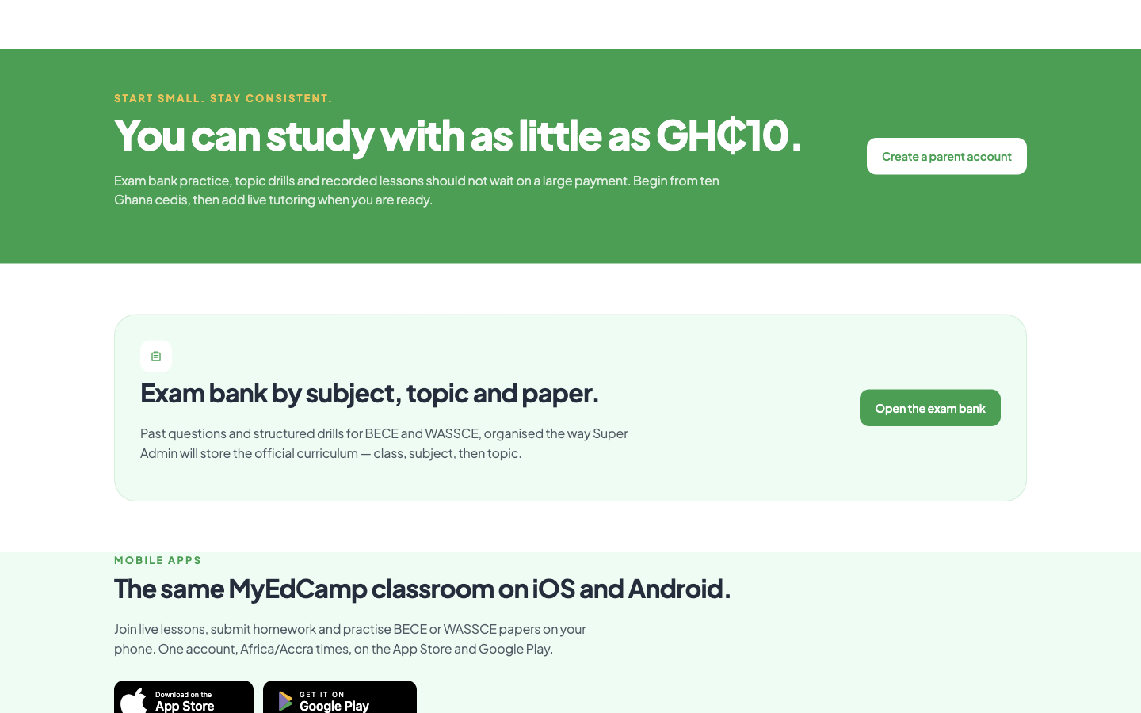
PRODUCT PROOF
Entry price from GH₵10
Exam bank, drills and recorded lessons can start from ten Ghana cedis.
MyEdCamp · Stakeholder briefing · Ghana
10 / 44

Slide 11
THE MARKET PROBLEM
Ghana does not lack tutors. It lacks an accountable way to buy extra learning
Families already pay for extra classes. Many of those classes are one-off.
Exam preparation is often delayed until a crash course.
Homework from a private arrangement is easy to abandon, because the parent is not in the record.
When the parent pays the teacher directly, nobody holds attendance, marking, and improvement in one place.
A strong teacher in one area is invisible to a child somewhere else.
MyEdCamp · Stakeholder briefing · Ghana
11 / 44

Slide 12
WHAT MYEDCAMP IS
Structured extra learning, with the parent in the account and the teacher on the payroll
It is not a replacement for the child’s school. The child stays in KG, primary, JHS, or SHS.
It is the accountable layer around live lessons, practice, homework, mocks, and progress.
It is not a marketplace where tutors list themselves and keep the fee.
It is not a video library with no one responsible for attendance.
Learn. Practise. Progress. is the whole offer in three words.
MyEdCamp · Stakeholder briefing · Ghana
12 / 44

Slide 13
WHAT THE PLATFORM DOES
The first five promises
Structured online tutoring: live and recorded lessons on a planned path.
Personalised learning: practice follows what that student still needs.
Homework accountability: assigned, submitted, marked, followed up.
Exam preparation: BECE and WASSCE sit in the same weekly cycle.
Parental visibility: the parent creates the family and can see whether the child is keeping up.
MyEdCamp · Stakeholder briefing · Ghana
13 / 44

Slide 14
WHAT THE PLATFORM DOES
The rest of the promise
Student accountability: attendance, submission, and improvement are visible.
An exam bank of past questions and drills, by subject, topic, and paper.
Progress over time, not a single score with no history.
Mentorship and academic guidance, only inside an approved relationship.
A starting price of GH₵10 so practice is not reserved for families who can pay a full private term on day one.
MyEdCamp · Stakeholder briefing · Ghana
14 / 44

Slide 15
THE LEARNING LOOP
A week of work, then the cycle starts again
1. Learn. The live lesson and the resources.
2. Practise. Exercises and the exam bank.
3. Apply. Homework.
4. Submit. The student hands the work in.
5. Assess. Tests and mocks.
6. Feedback. The teacher marks. 7. Improve, then return to Learn.
MyEdCamp · Stakeholder briefing · Ghana
15 / 44

Slide 16
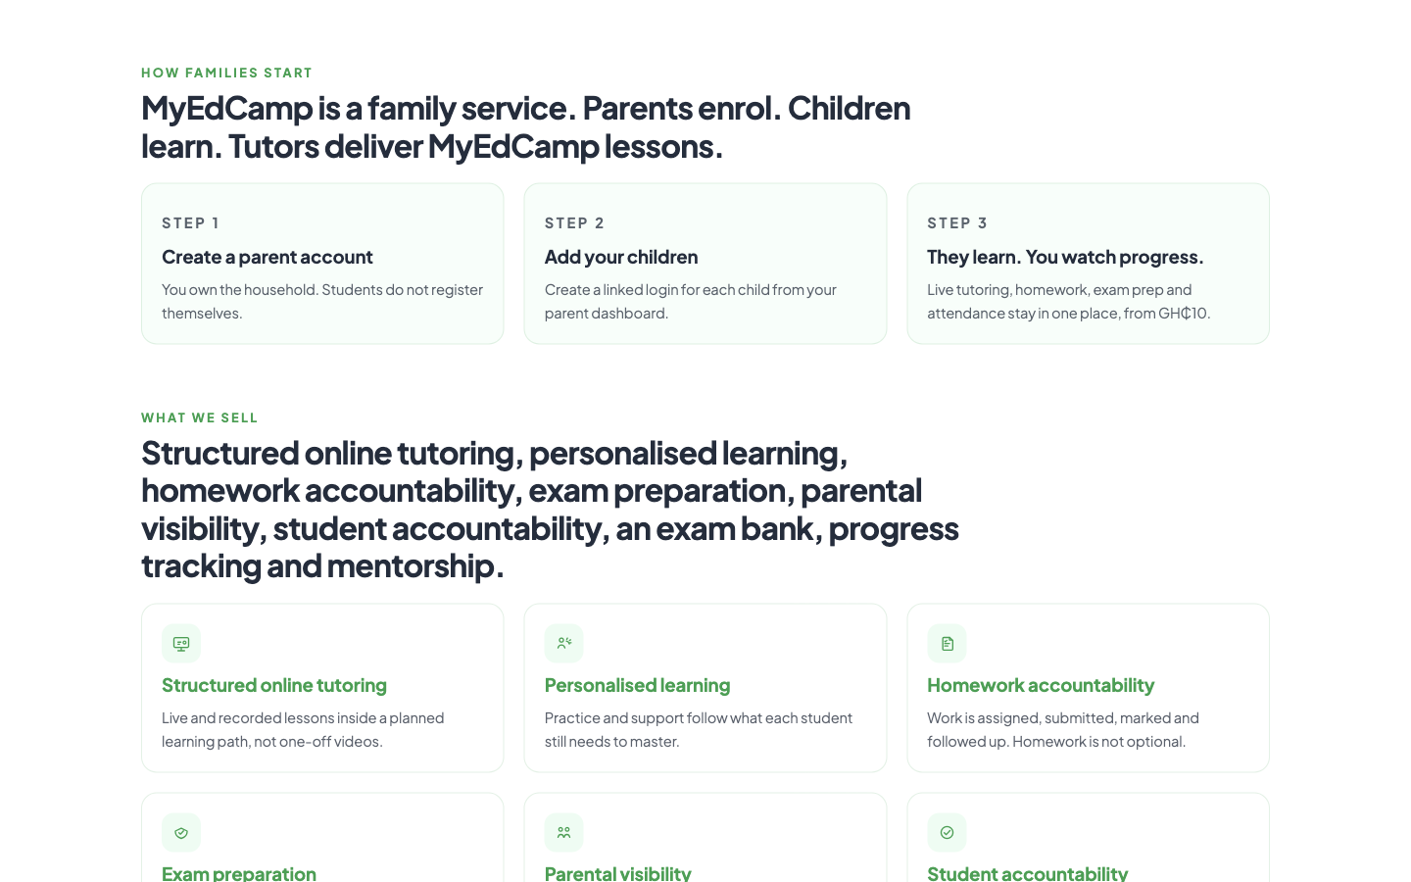
PRODUCT PROOF
How families start and what we sell
Parent account → add children → watch progress. Nine services listed on the public site.
MyEdCamp · Stakeholder briefing · Ghana
16 / 44

Slide 17
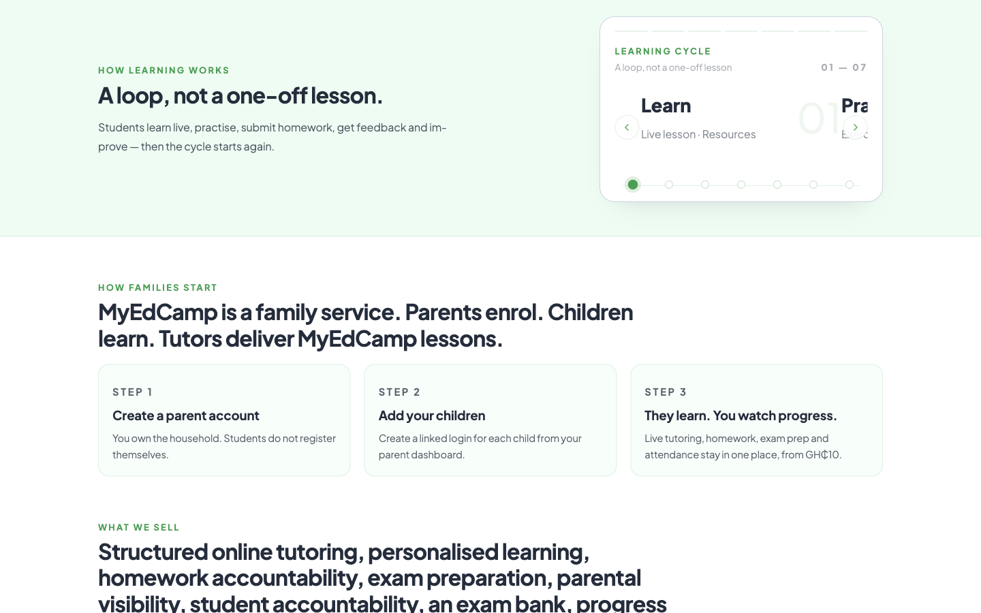
PRODUCT PROOF
The weekly learning cycle
Learn → Practise → Apply → Submit → Assess → Feedback → Improve.
MyEdCamp · Stakeholder briefing · Ghana
17 / 44

Slide 18
BUSINESS ARCHITECTURE
Twelve operating rules — first half
MyEdCamp owns the lesson. Teachers deliver it.
One parent owns the household. Children are added under that parent.
Parents pay MyEdCamp. They do not pay the teacher.
Teachers are paid by MyEdCamp for approved delivery.
The timetable belongs to the platform. A teacher cannot set class times.
The question bank belongs to MyEdCamp.
MyEdCamp · Stakeholder briefing · Ghana
18 / 44

Slide 19
BUSINESS ARCHITECTURE
Twelve operating rules — second half
Parent revenue and teacher compensation are separate books.
Safeguarding is a restricted case file, not a support ticket.
Operations is split by desk: academics, welfare, technology, safeguarding, marketing, platform, and reporting.
Super Admin can open every module. An operations admin does not hold those powers.
Live classes use the MyEdCamp video account.
Time is Africa/Accra. The currency of the promise is the Ghana cedi.
MyEdCamp · Stakeholder briefing · Ghana
19 / 44

Slide 20
THE CAST
Each person has a job and a boundary
Parent: enrols, pays MyEdCamp, watches progress.
Student: attends, practises, submits. Cannot register alone.
Teacher: teaches, marks, records attendance. Does not set the timetable or collect fees.
Mentor: supports a learner only inside an approved relationship.
Academics: curriculum, lessons, class times, and teacher assignment.
Safeguarding: child-protection cases. Welfare handles ordinary welfare and complaints.
MyEdCamp · Stakeholder briefing · Ghana
20 / 44

Slide 21
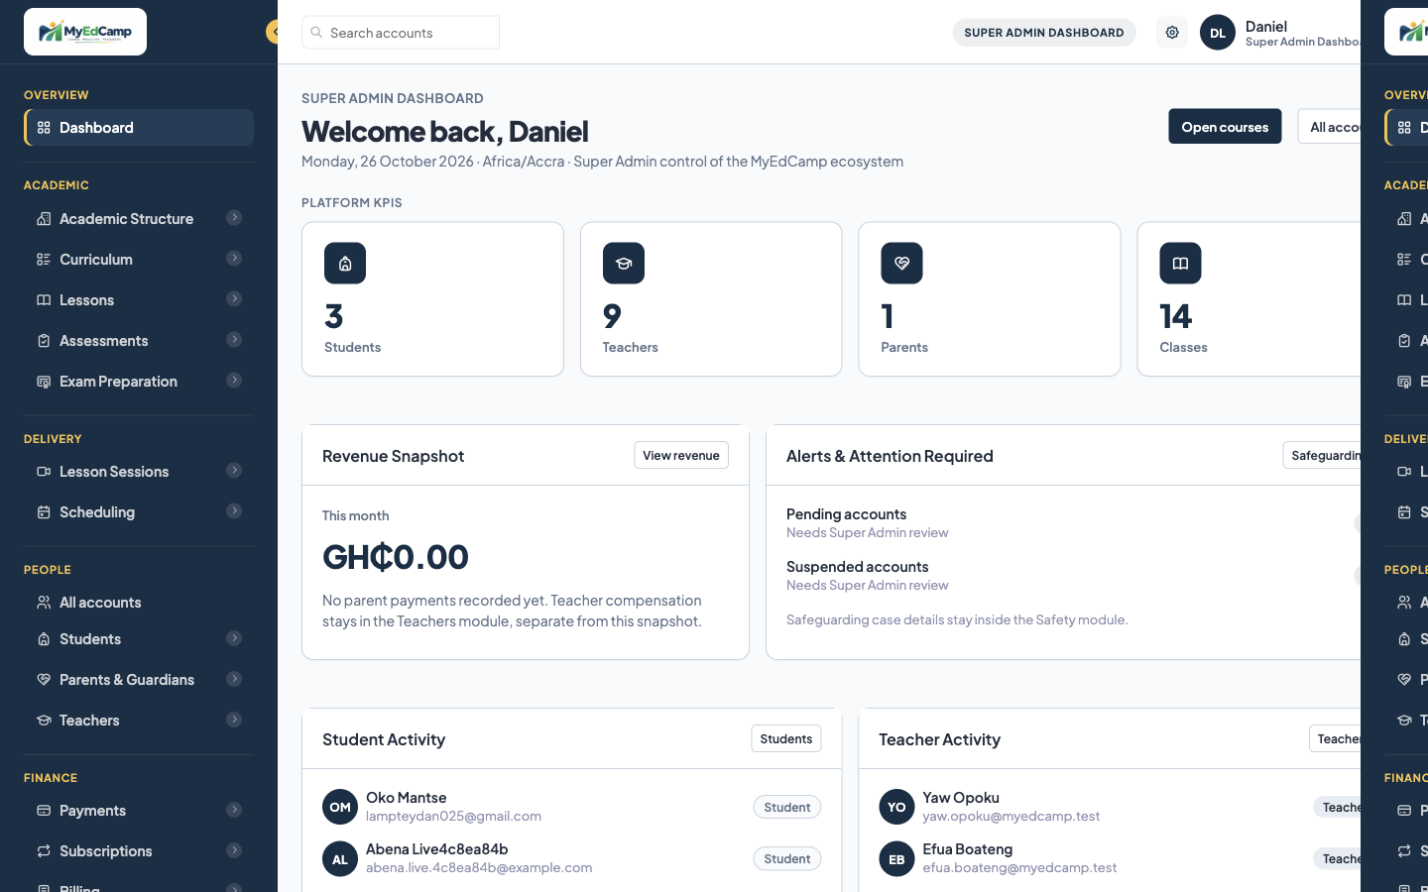
PRODUCT PROOF
Super Admin dashboard
Academics, delivery, people, finance and safeguarding are separate desks.
MyEdCamp · Stakeholder briefing · Ghana
21 / 44

Slide 22
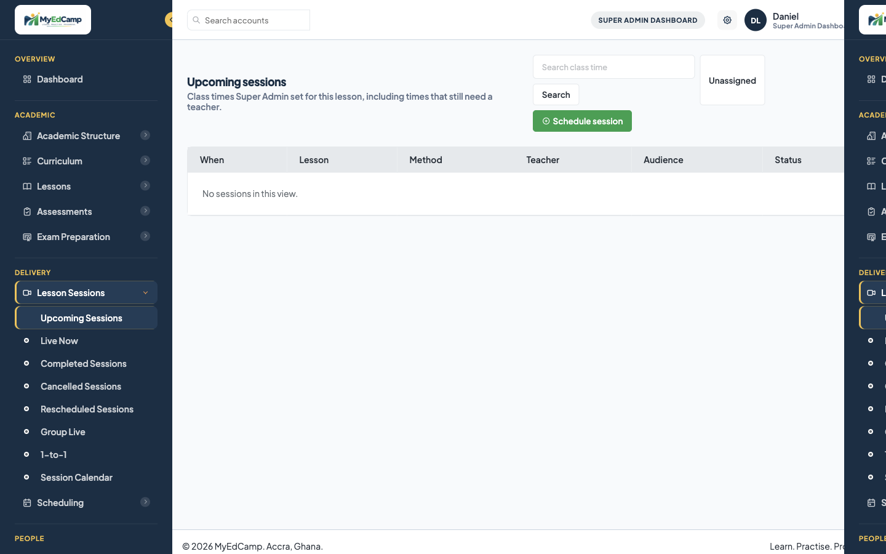
PRODUCT PROOF
Class times the platform sets
Upcoming sessions include times that still need a teacher. Unassigned is an operations task.
MyEdCamp · Stakeholder briefing · Ghana
22 / 44

Slide 23
WHERE PARENTS COME IN
The parent is the customer
Step 1. The parent creates the MyEdCamp account and owns the household.
Step 2. The parent adds each child and sets the sign-in that child will use.
Step 3. The parent finds lessons: subject lessons, BECE, WASSCE, and mocks.
Step 4. The parent enrols the child and chooses a class time the platform has already set.
Step 5. The parent pays MyEdCamp, starting from GH₵10 for study.
Step 6. The parent watches attendance, homework, results, and progress.
MyEdCamp · Stakeholder briefing · Ghana
23 / 44

Slide 24

PRODUCT PROOF
Public parent promise
Parents enrol. Children learn. Choose Super Admin class times. See progress in one place.
MyEdCamp · Stakeholder briefing · Ghana
24 / 44

Slide 25
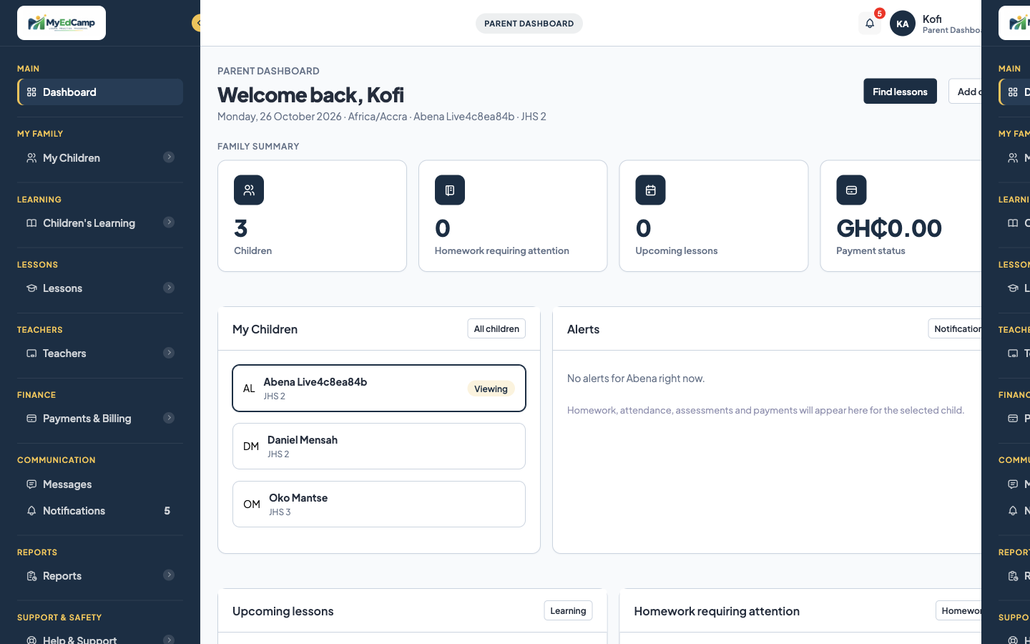
PRODUCT PROOF
Parent dashboard
Selected child, homework requiring attention, upcoming lessons, payment status.
MyEdCamp · Stakeholder briefing · Ghana
25 / 44

Slide 26
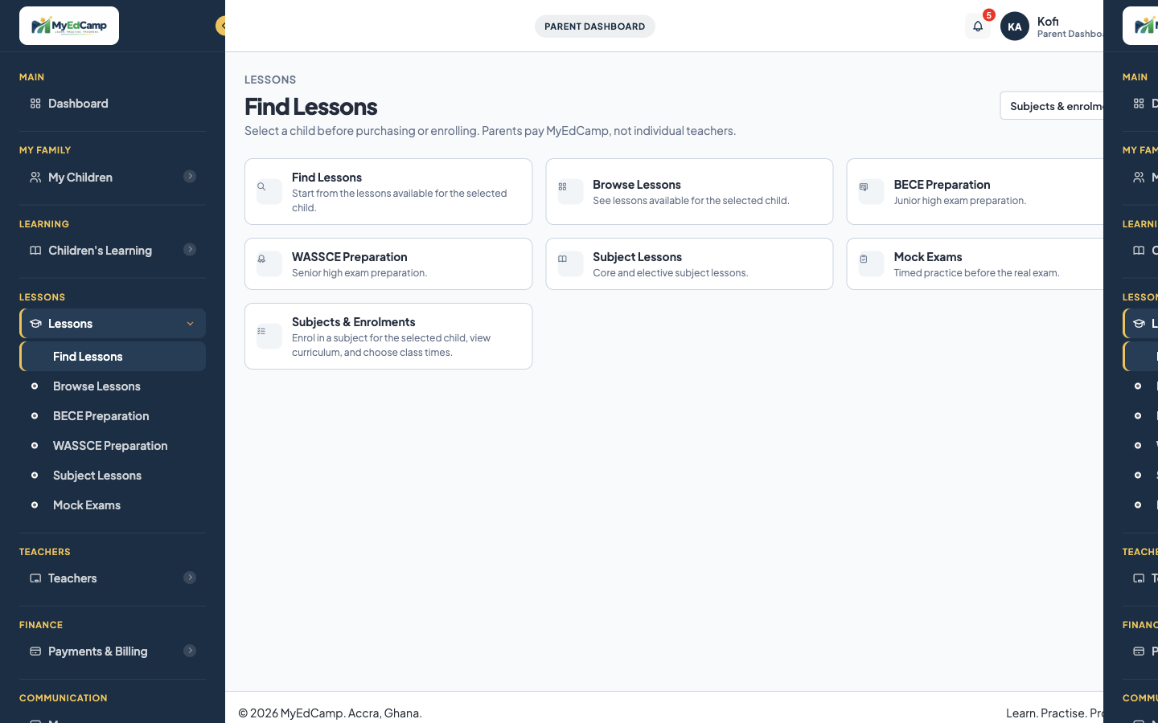
PRODUCT PROOF
Find Lessons
On screen: Parents pay MyEdCamp, not individual teachers.
MyEdCamp · Stakeholder briefing · Ghana
26 / 44

Slide 27
WHERE STUDENTS COME IN
The student is the learner, not the buyer
The student joins the live lesson, practises, and submits homework.
BECE or WASSCE practice is the exam that matches their class.
The student, the teacher, and the parent see the same facts: attendance, submission, and improvement.
The website is the system of record. Mobile is the product direction.
A child must not be able to open an account, choose a stranger, and pay them.
MyEdCamp · Stakeholder briefing · Ghana
27 / 44

Slide 28
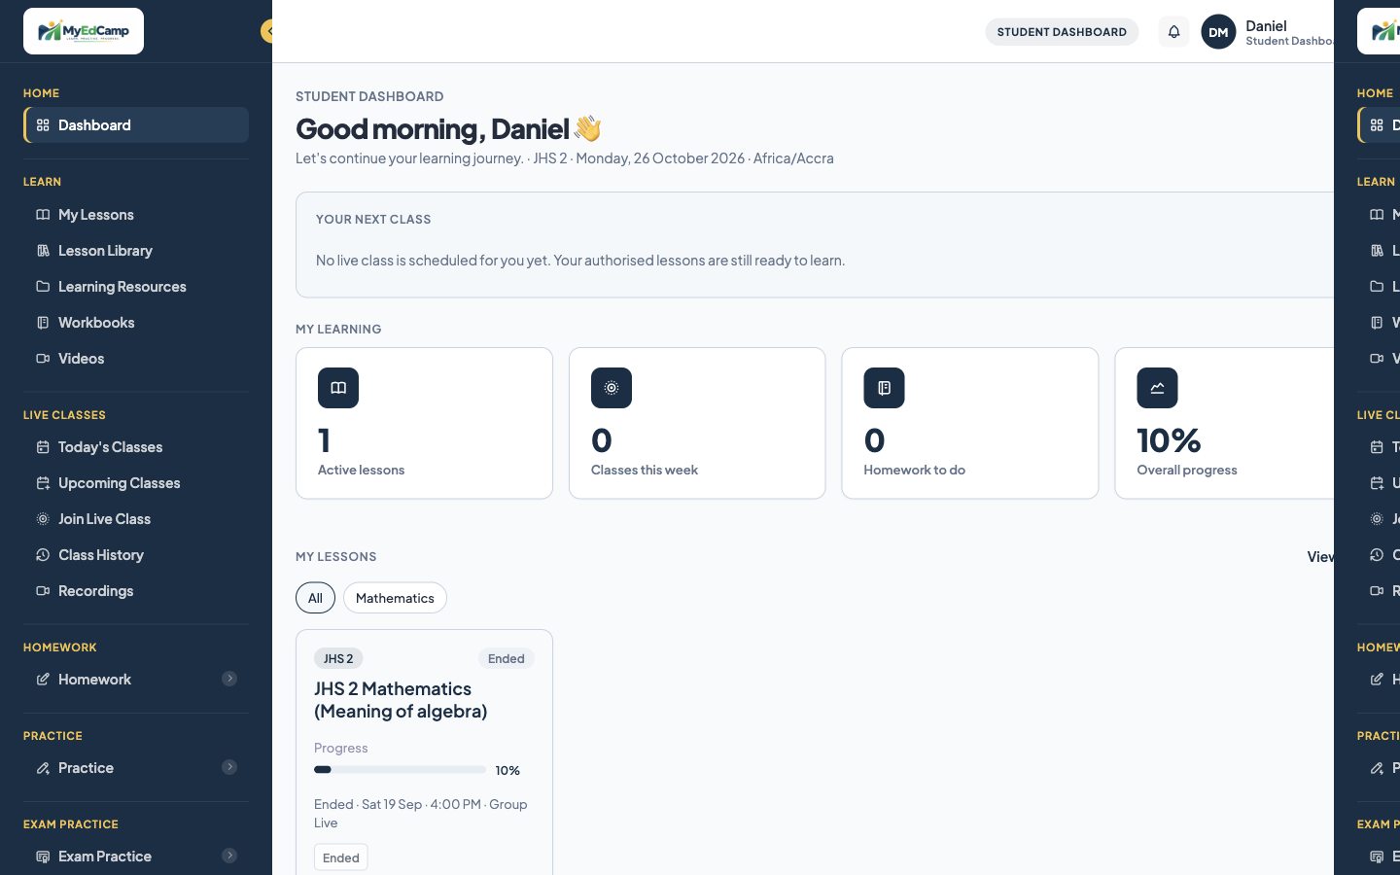
PRODUCT PROOF
Student dashboard
Active lessons, homework, progress and live classes — learner tools, not payment tools.
MyEdCamp · Stakeholder briefing · Ghana
28 / 44

Slide 29
WHERE TEACHERS COME IN
Employment, not a stall in a marketplace
Say this before rates: you are employed to deliver MyEdCamp lessons.
You teach the subject you are assigned, at the class time the platform set.
You mark the homework and you record who attended.
You do not bring your own course, set your own timetable, or collect money from parents.
You can report a safeguarding concern. You cannot browse other cases.
You do not own the official question bank.
MyEdCamp · Stakeholder briefing · Ghana
29 / 44

Slide 30
THE TEACHER’S PATH IN
Applying is not the same as being put on a class
1. The teacher applies through Become a Teacher. That starts onboarding only.
2. They complete the profile, submit verification documents, and accept policies.
3. Super Admin can ask for more information, verify, approve, reject, hold, activate, suspend, or set inactive.
4. Activation is refused until the policies are accepted and at least one document is verified.
5. The activation message: you will be assigned to a subject and to class times. You do not own courses.
MyEdCamp · Stakeholder briefing · Ghana
30 / 44

Slide 31
AFTER ACTIVATION
How a teacher meets a class
Academics assigns the teacher to a subject.
The class time already exists. An unassigned time is an operations task.
The teacher sees only the students on the lessons they are assigned to teach.
They start the session, teach, mark, and record attendance.
If they are suspended or set inactive, access stops. History stays.
MyEdCamp · Stakeholder briefing · Ghana
31 / 44

Slide 32

PRODUCT PROOF
Public teacher promise
Super Admin assigns the subject and sets class times. Teachers do not sell their own courses.
MyEdCamp · Stakeholder briefing · Ghana
32 / 44

Slide 33
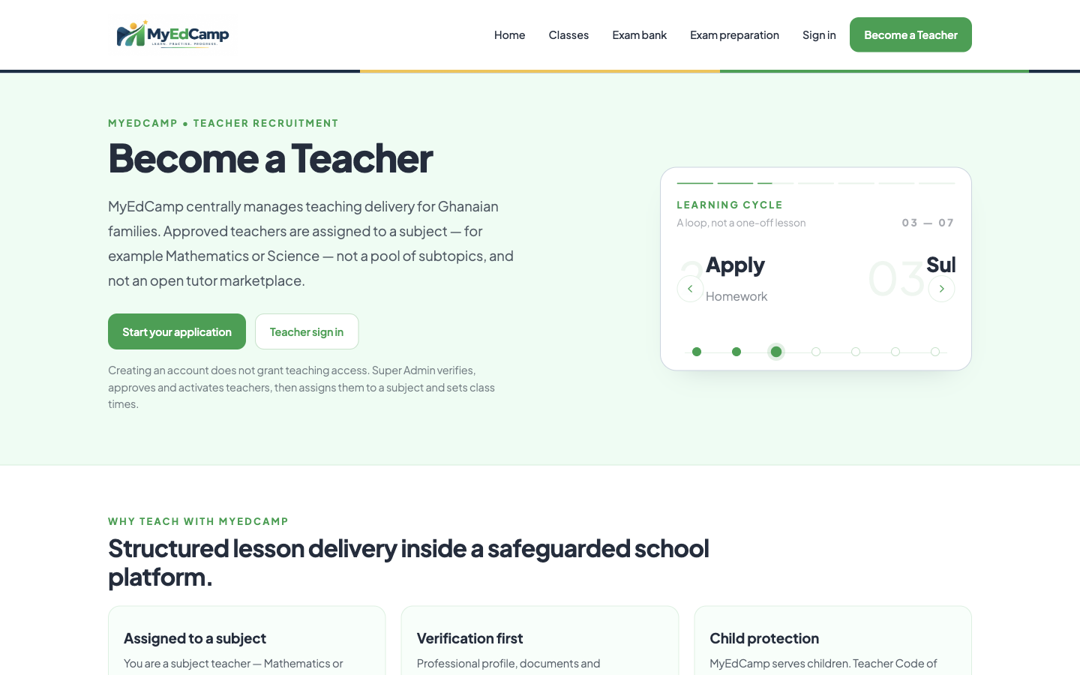
PRODUCT PROOF
Become a Teacher
Creating an account does not grant teaching access. Super Admin verifies and activates.
MyEdCamp · Stakeholder briefing · Ghana
33 / 44

Slide 34
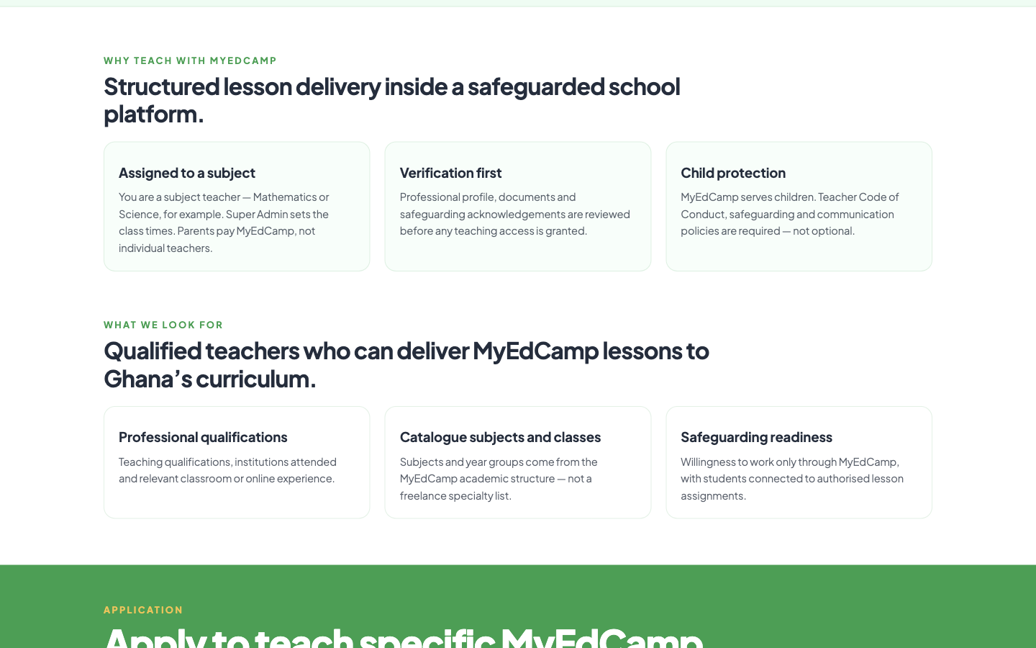
PRODUCT PROOF
Why teach with MyEdCamp
Assigned to a subject. Verification first. Child protection required. Parents pay MyEdCamp.
MyEdCamp · Stakeholder briefing · Ghana
34 / 44

Slide 35
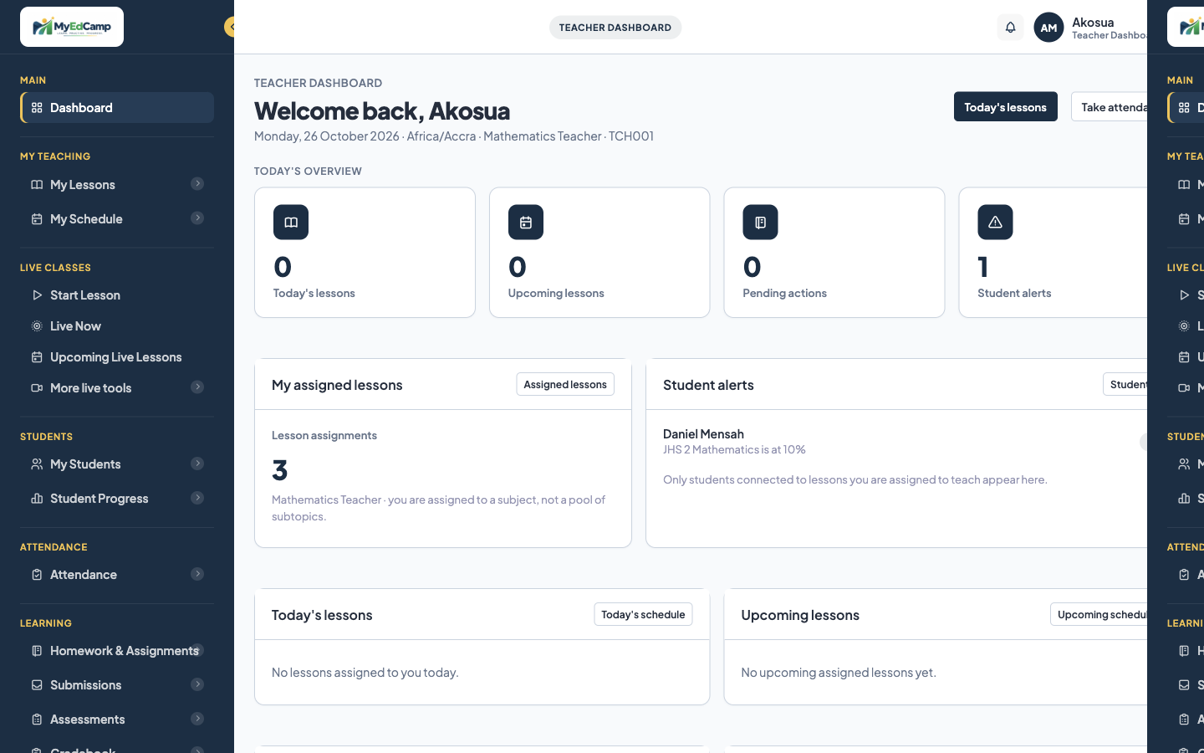
PRODUCT PROOF
Teacher dashboard
Assigned lessons, schedule, students, homework and earnings — scoped to that teacher.
MyEdCamp · Stakeholder briefing · Ghana
35 / 44

Slide 36
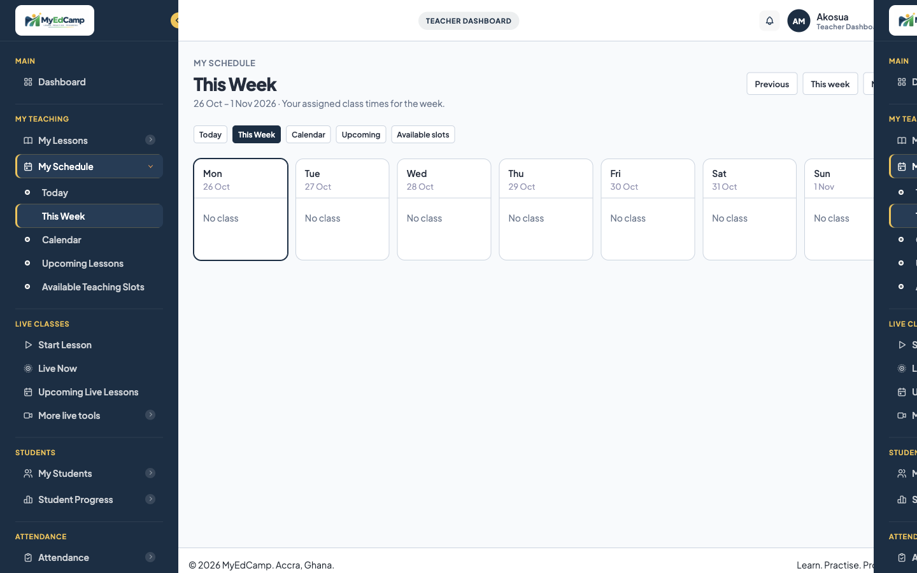
PRODUCT PROOF
Teacher schedule
This week’s assigned class times from the platform.
MyEdCamp · Stakeholder briefing · Ghana
36 / 44

Slide 37
REMUNERATION
Parents pay MyEdCamp. MyEdCamp pays the teacher.
This is employment pay, not a commission on families the teacher recruited.
There is no corridor payment after class.
Family revenue and teacher compensation are separate records on purpose.
MyEdCamp sets the compensation model and writes it on the teacher record.
A completed class carries a compensation status. It begins as pending approval.
Pay follows an approved record. A verbal claim that a class happened is not the record.
MyEdCamp · Stakeholder briefing · Ghana
37 / 44

Slide 38
THE PAYABLE LESSON
Five steps, in this order, then approval
Assigned. The teacher is on that subject and that lesson.
Scheduled. The platform set the class time.
Delivered. The class was taught.
Attendance recorded. The names are on the register.
Completed. The session is closed.
Only then does compensation move from pending approval to approved pay.
MyEdCamp · Stakeholder briefing · Ghana
38 / 44

Slide 39
WHAT TO TELL TEACHERS ABOUT MONEY
The rule is fixed. The payslip screen is not the thing to demonstrate
Tell them they will be paid by MyEdCamp for approved, delivered lessons.
Tell them the five-step record, so they understand why attendance and completion matter.
Tell them the model that applies to them will be set by the platform.
Do not quote a rate that has not been written into that record.
Do not promise an automatic payslip on day one.
Do promise that suspension does not erase historical lesson and pay records.
MyEdCamp · Stakeholder briefing · Ghana
39 / 44

Slide 40
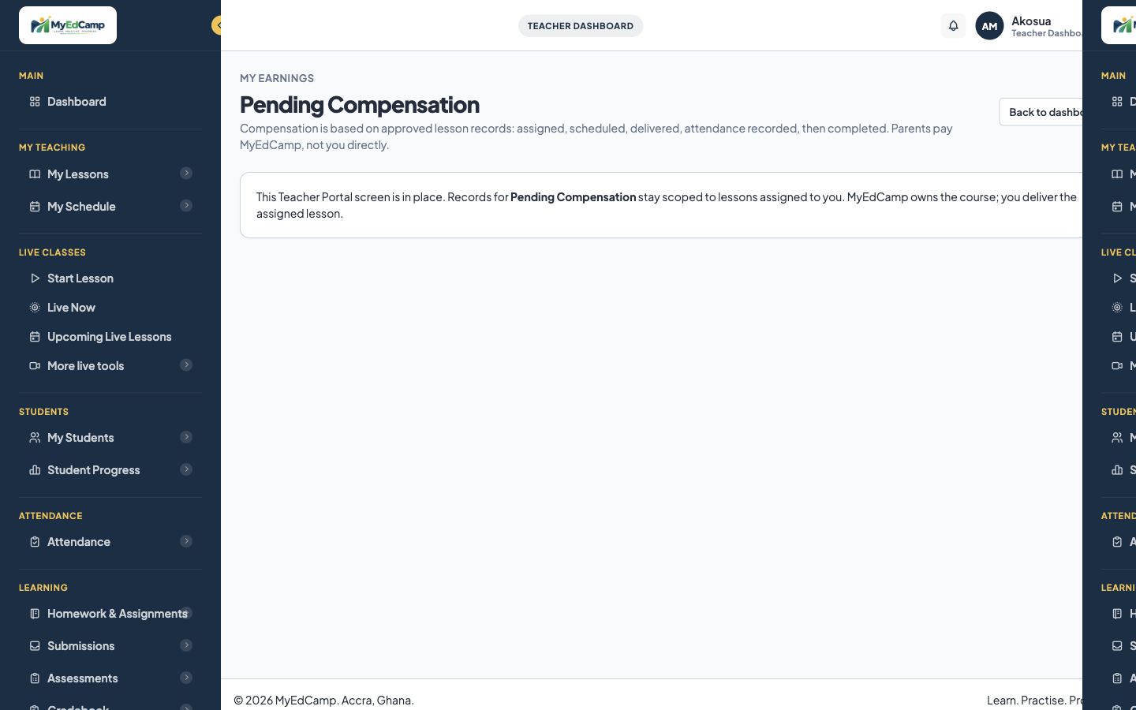
PRODUCT PROOF
Pending Compensation
On screen: assigned, scheduled, delivered, attendance recorded, then completed. Parents pay MyEdCamp, not you directly.
MyEdCamp · Stakeholder briefing · Ghana
40 / 44

Slide 41
THE OPERATIONS MANAGER
You are running a school operation
The daily objects are class times, teacher assignment, unassigned sessions, attendance, homework, and family enrolment.
A teacher who has only applied is not yet someone you can place on a class.
An unassigned class time is your problem to fill.
Parent money and teacher pay must never be one report or one conversation.
Safeguarding does not sit in the general support queue.
You can explain the pay rule today. Plan the checkout and the payslip as the operational build still in front of you.
MyEdCamp · Stakeholder briefing · Ghana
41 / 44

Slide 42
MONEY IN ONE PICTURE
Two directions, never one handshake
Family to MyEdCamp: enrolment and study fees, from GH₵10 upward.
MyEdCamp to teacher: remuneration for an approved lesson record.
There is no arrow from family to teacher.
Invoices, subscriptions, and refunds stay on the family side.
Compensation status stays on the teacher side.
If a stakeholder draws a line from parent to teacher, correct the drawing before the meeting moves on.
MyEdCamp · Stakeholder briefing · Ghana
42 / 44

Slide 43
WHAT NOT TO OVERCLAIM
Honesty is part of the pitch to people you will employ
Do not demonstrate a finished parent checkout.
Do not demonstrate an automatic payslip. Describe the five-step record and the approval.
Do not quote a live-class price that leadership has not published. GH₵10 is the starting point for study.
Do not say the mobile apps are already the daily classroom. They are the direction.
Do not say MyEdCamp replaces the child’s school.
MyEdCamp · Stakeholder briefing · Ghana
43 / 44

Slide 44
IF YOU REMEMBER ONLY THIS
The line to leave in the room
MyEdCamp is a platform for Ghanaian students, from kindergarten to the WASSCE year.
Parents own the account and pay MyEdCamp.
Teachers are employed to deliver lessons the platform owns, on times the platform sets.
Students do the work, and the parent can see whether it was done.
Pay follows an approved class record. It does not follow a private arrangement.
Learn. Practise. Progress.
MyEdCamp · Stakeholder briefing · Ghana
44 / 44

